Slide 1



Slide 2
February 2026 A&P Monthly Meeting
Notes:
Good Morning, as you’re A&P chair and on behalf of the A&P executive team, I call our February 2026 monthly meeting to order. A&P Place Representatives and Committee Members, please use the link in the chat to mark your attendance. In accordance with Article IV, Section 1C, a quorum is established when 50% of elected members, not counting any of the chairs) are present. While our elected members note their attendance, we’ll cover some news and updates.

Slide 3



What’s New Around Auburn
Notes:
As we continue working to strengthen A&P Assembly Meeting organization and ensure we are operating in alignment with our constitution, we will transition to conducting our meetings in accordance with Roberts Rules of Order Newly Revised. Our goal in doing this is to promote clarity and efficiency in how we discuss and make decisions. Roberts Rules provides a structured process that ensures every member has an opportunity to be heard while helping our meetings stay organized and productive. Throughout today’s meeting, we ask all assembly members to raise their hand and be acknowledged prior to speaking. You are also encouraged to post questions to our speakers using the Q&A format.
Auburn Student Government Association announced their newest major representatives of the student body. We’re excited to welcome Willis Orr as President, Lilly Pool as Vice President, Jackson Morse as Treasurer and Riley Johnson as Miss Auburn.

Slide 4
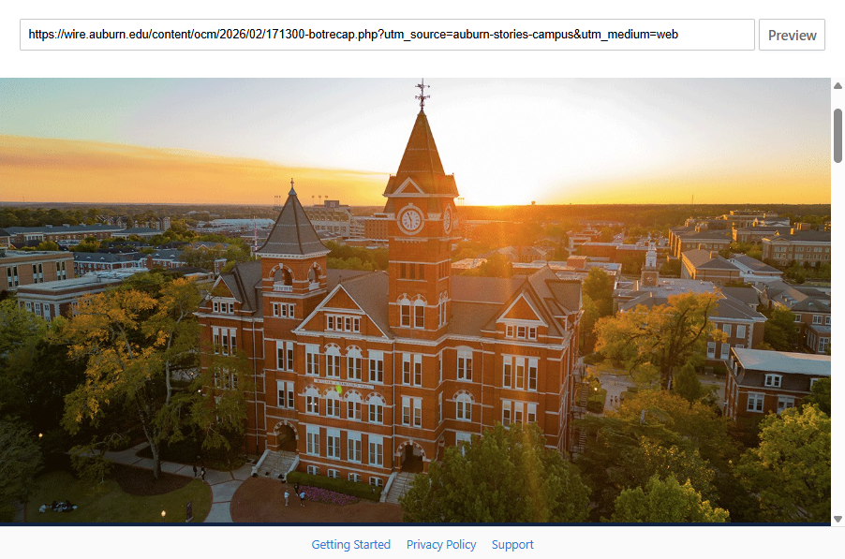
What’s New Around Auburn
Notes:
On Friday, February 13th, Auburn’s Board of Trustees held their first meeting of 2026 on Auburn University at Montgomery’s campus. As part of the meeting, The Audit and Compliance Committee, chaired by Billy Ainsworth, received a “clean bill” from PWC regarding the university’s financial statements. President Roberts also shared that Auburn University has been recognized by FORBES as a top 100 best large employers in 2026.

Slide 5

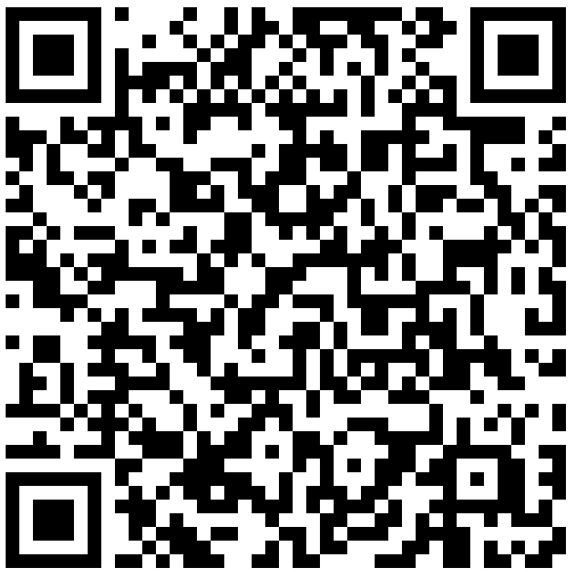
What’s New Around Auburn
Notes:
https://auburn.edu/academic/provost/america250/
Throughout 2026, in honor of the 250th anniversary of our nation, the university will host events and offer opportunities to reflect on the ideals that shaped the United States and continue to influence civic life and democratic institutions. The office of the provost has prepared a website to continuously update employees, students and the general public on upcoming events. The first signature speaker series is March 30th at GPAC, featuring Secretary Condoleeza Rice and Commentator Margaret Hoover. The QR code on this slide will direct you to GPAC’s ticket link to reserve your ticket.

Slide 6
Quorum?
Notes:
Deepa, can you please confirm that we have reached the necessary 50% to establish a quorum? The meeting minutes from our January 2026 meeting can be found on the A&P Assembly website. Do I have any amendments to the minutes? If none, the minutes are approved.

Slide 7
Committee Updates
Notes:
Our first committee update will be presented by our Welfare Committee. Laura, you have the floor.

Slide 8
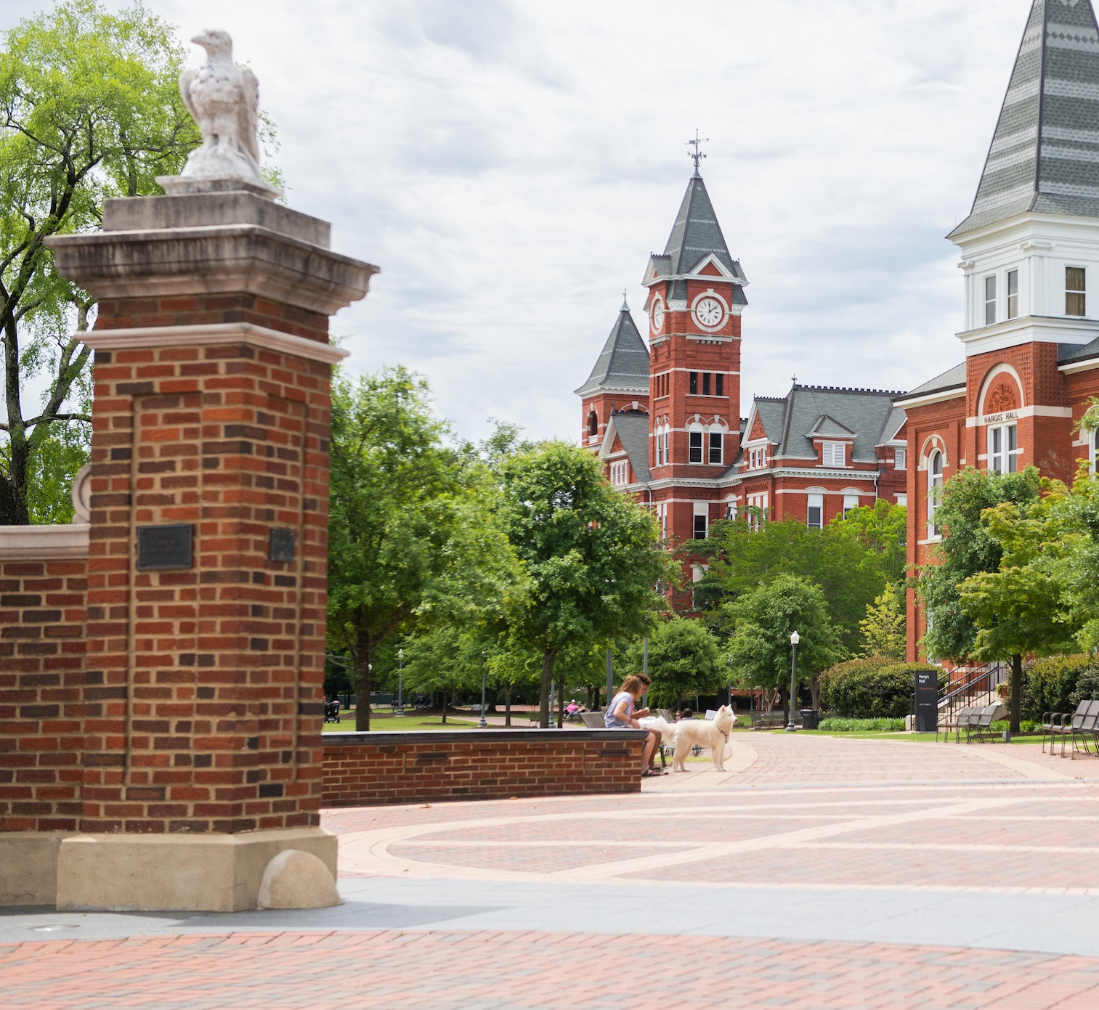
Tiger Tips: Know your benefits
A&P Welfare committee

Slide 9
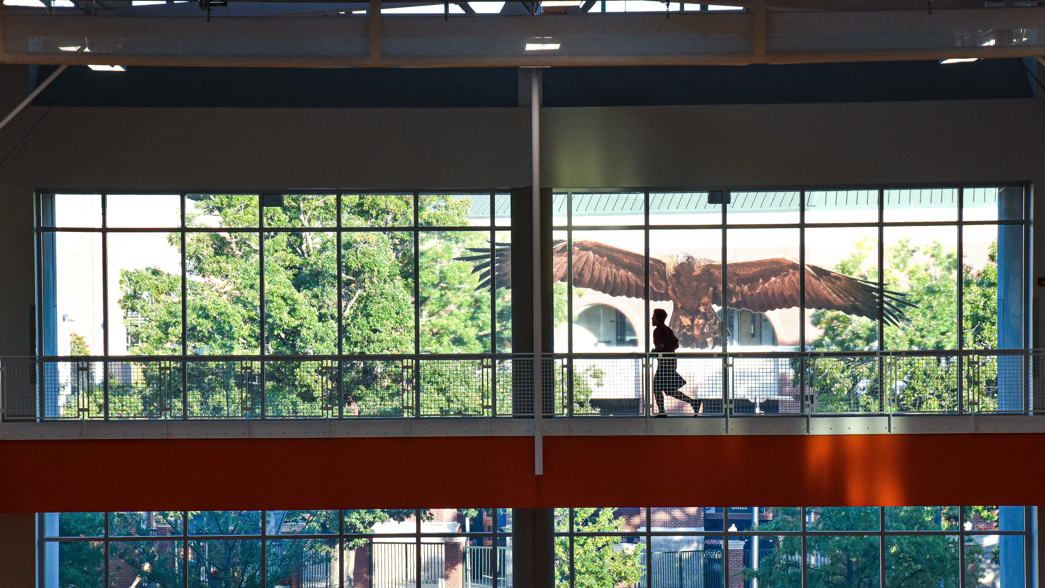

Welcome to Recreation and Wellness!

Slide 10

Membership Information Auburn University Faculty/Staff

Slide 11
OneRec Memberships
Eligibility
Full-time 12-month employees and spouse/partner
Full-time 9-month employees and spouse/partner
Retirees of Auburn University and spouse/partner
Membership Pricing (no long-term commitment)
Full-time 12-month employees and spouse/partner
  $25/month each via payroll deduction
Full-time 9-month employees and spouse/partner
  $30/month each via payroll deduction
Retirees of Auburn University and spouse/partner
  $25/month each via credit card
What is included?
Your OneRec Membership includes facility access to the Recreation and Wellness Center, SportsPlex, West Campus Field House (Tennis/Pickleball) and Intramural Fields.
OneRec Members enjoy comprehensive program access to Auburn Outdoors, Competitive Sports, Group Fitness, and Personal Training, creating a seamless, all-in-one recreation experience.
With several complimentary offerings included, OneRec empowers members to explore new activities, build skills, and prioritize their well-being.

Slide 12

Recreation and Wellness Center
Facility Highlights
240,000 Square Feet of recreation space
1/3-mile indoor ribbon track with elevation change
8 multipurpose courts (basketball, volleyball…etc.)
Dedicated weight, cardio, and stretching areas
Multiple studios for group fitness
Leisure pool with cold plunge tubs and hot tub
The goal is to provide members with the best possible tools to improve their overall health and wellness. The result is a facility that is uniquely Auburn.

Slide 13
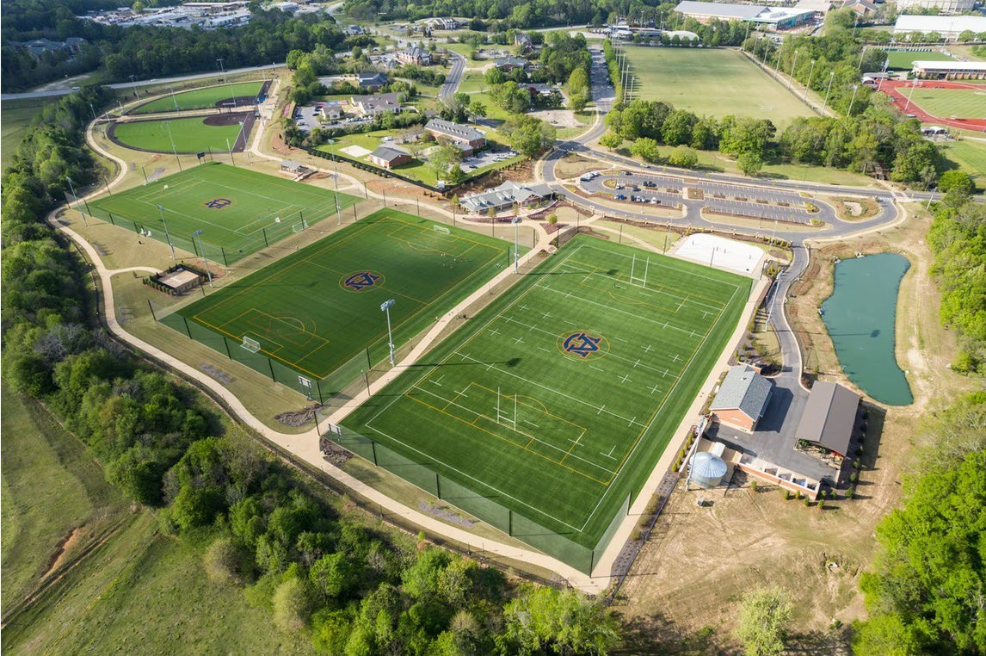
SportsPlex and Intramural Fields
Facility Highlights
30 acres of turfed field space (SportsPlex)
  One-mile outdoor walking track
  Two softball/baseball fields
  Two sand volleyball courts
  Three multiuse fields
15 acres of recreational field space (IM Field)
The SportsPlex is a state-of-the-art recreational facility serving as a hub for fitness, sport, and outdoor recreation opportunities.
The Intramural Field provides both informal and programmatic opportunities for members.

Slide 14
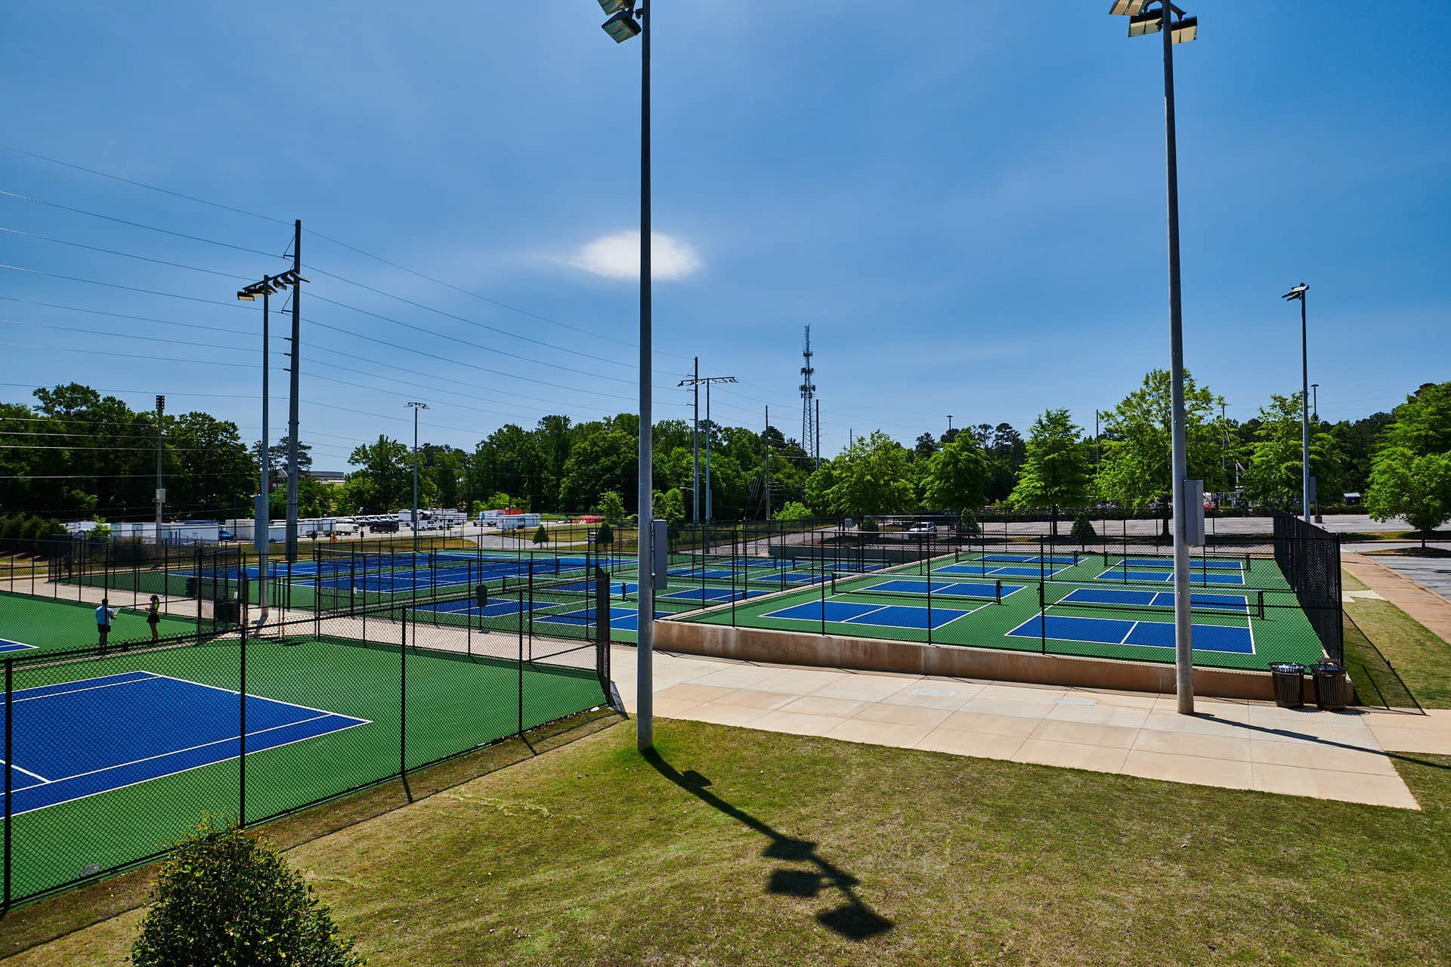
West Campus Field House
Facility Highlights
Field House with dedicated equipment check-out
Eight pickleball courts
11 tennis courts
Lighted area for nighttime play
After hours equipment check-out
Located at the corner of Thach Avenue and Hemlock Drive, the West Campus Field House and its dedicated Pickleball and Tennis Courts expand the footprint for additional recreation, connection, and competition opportunities.

Slide 15

Common Questions
When is “The Rec” open?
Monday – Thursday: 5:30am – 11pm
Friday: 5:30am – 9pm
*Saturday: 9am – 6pm
  *Closed for home football games
Sunday: 12pm – 10pm
When is it busy?
Member traffic is typically spread throughout the day
  Certain times are more active (mid-afternoon)
The Rec has multiple workout neighborhoods rather than a single “cardio” or “weight” room
  This allows members to choose the environment that fits their preference

Slide 16


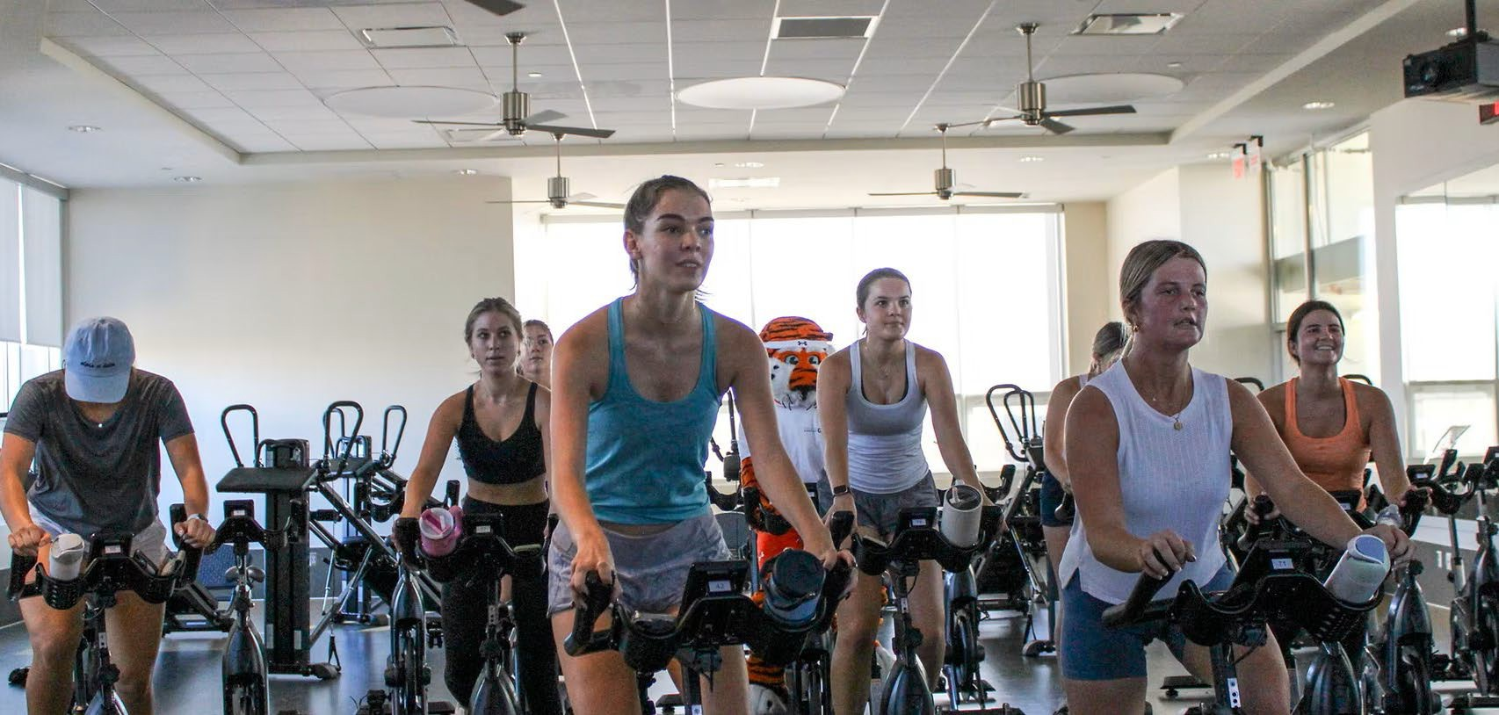
Common Questions
What Group Fitness classes are available?
More than 90 classes per week
Yoga, Pilates, Cycling, Strength, Zumba, Barre
All classes are included with OneRec Membership
  Register for classes via RWC Connect

Slide 17

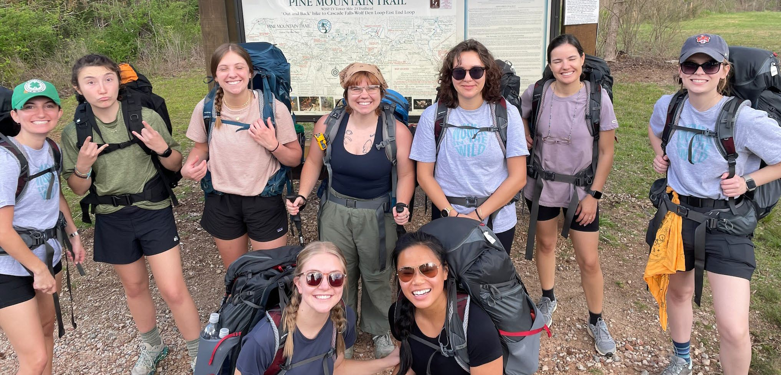

Common Questions
What does Auburn Outdoors offer?
Land and water-based equipment rentals
  Canoes, kayaks, tents, bikes, sleeping bags
  Rental packages
  Trip planning

Slide 18

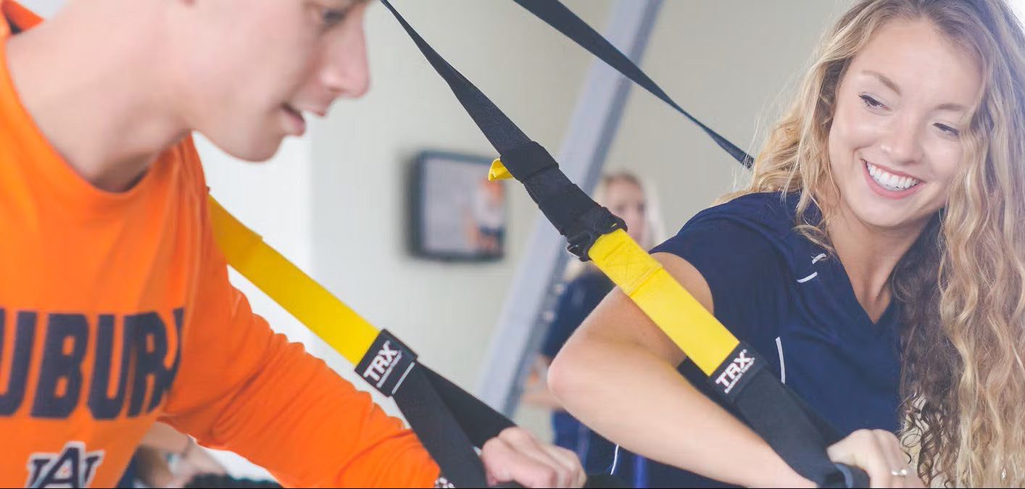
Common Questions
How do Personal Training* sessions work?
Flexible packages ranging from 1 to 24 sessions
  Allows you to choose the option that best fits your goals, schedule, and commitment level
Semi-private training options are available, providing a way to train with a partner while still receiving individualized coaching
Once a package is selected, sessions are scheduled directly with your trainer and designed around your specific fitness goals, experience level, and preferred training style
*You must have an active OneRec Membership to purchase Personal Training sessions

Slide 19
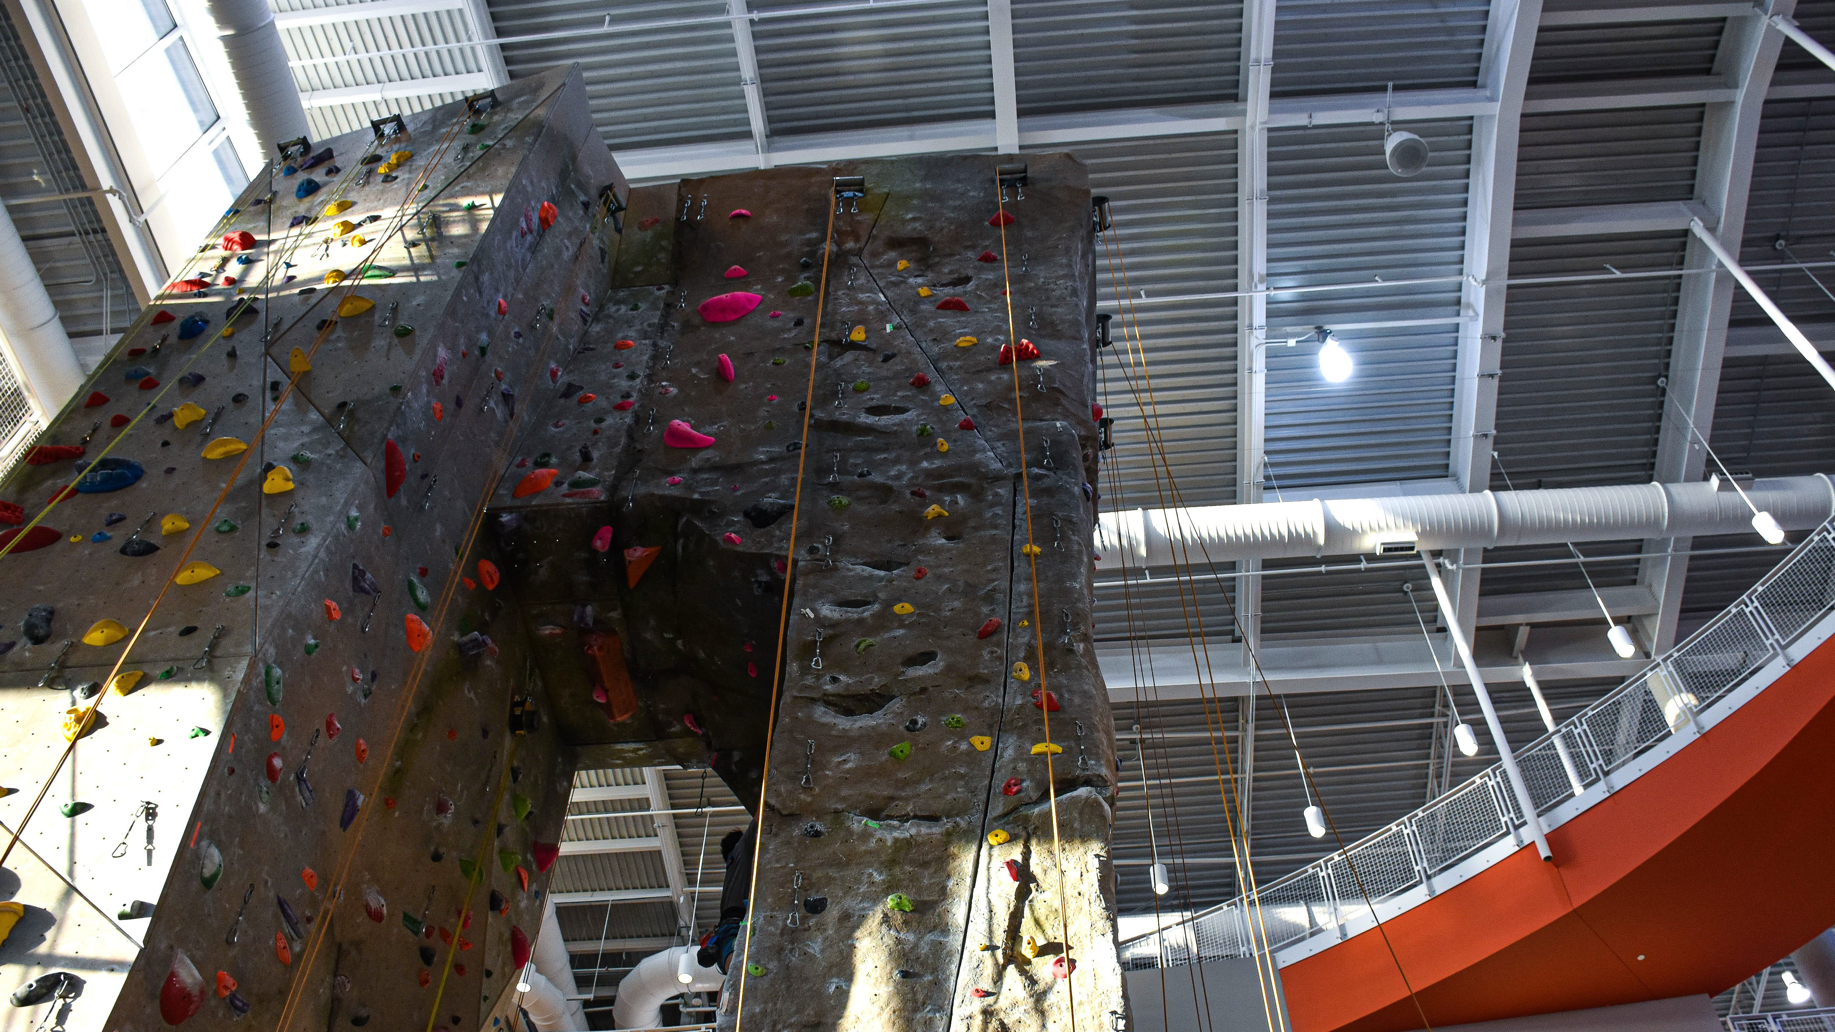

MORE INFO?
Contact Us
recmembership@auburn.edu

Slide 20
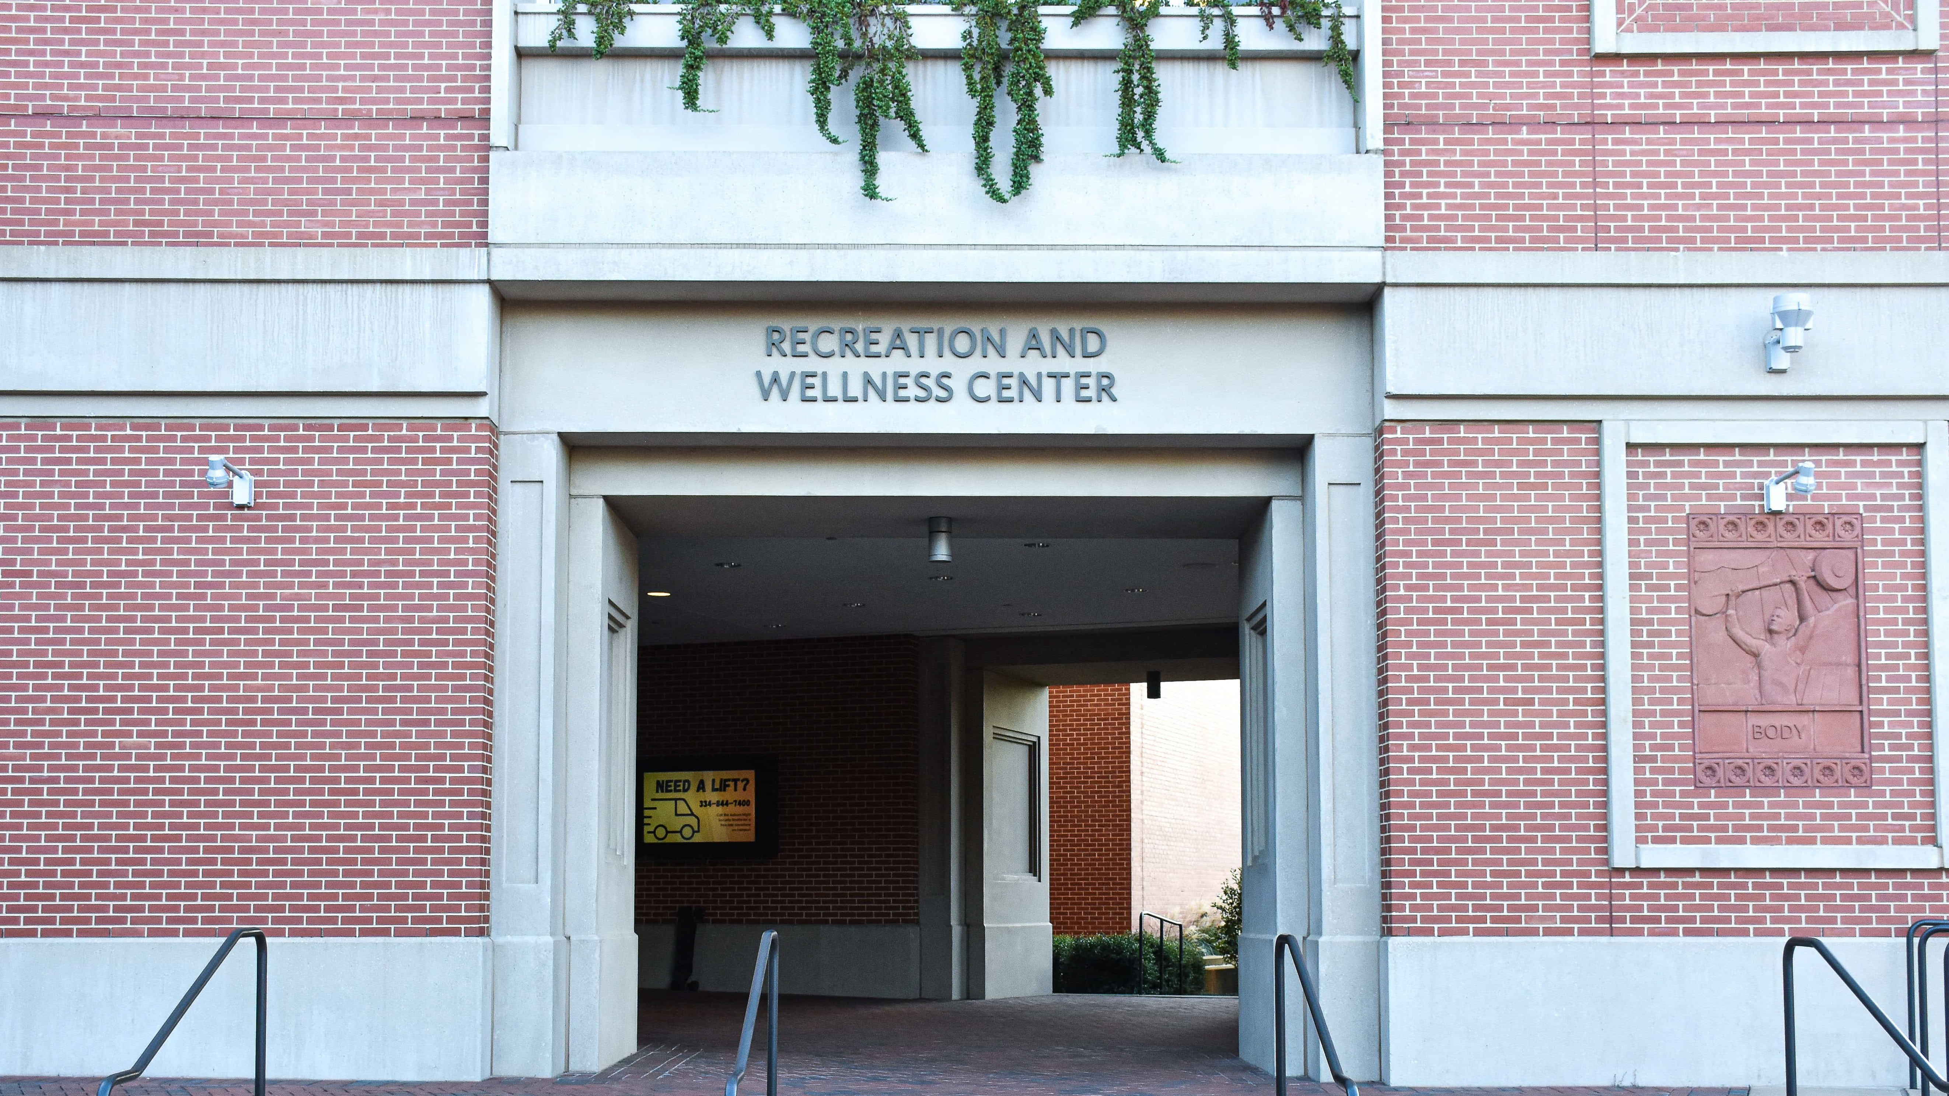

Thank you and War Eagle!
recwellness.auburn.edu

Slide 21
A&P Constitutional Review Update
Notes:
During our January 2026 A&P Meeting, the assembly members voted on the amendments to our constitution to better alignment with our current practice and while maintaining equal share among departments. The constitution requires ¾ vote of elected members who are both present and voting. Some elected members were present at the meeting, but did not cast a vote. Under Roberts Rules of order and the constitution’s language, members who are present but do not vote are treated as not voting, rather than as affirmative abstentions, unless otherwise specified. As a result, only those who voted “yes” or no” vote were counted in the total used to calculate the required ¾ threshold. We had a total of 14 members present and voting. The number of affirmative votes exceeded the ¾ majority of those present and voting. Although there was one dissenting vote, the number of affirmative votes was sufficient to meet the constitutional standard for passage. In conclusion, the proposed changes were determined to have validly passed. This conclusion was documented and supported by the voting record and governing rules.

Slide 22
2026 A&P Nominations
Nominations & Elections Committee

Slide 23
Auburn University
Academic & Professional Employee Governing Body
Version
2.00
Date
12 February 2026
A&P Assembly
Executive Committee
Past Chair
Chair
Chair-Elect
Secretary
Member-At-Large Member-At-Large
Place Representatives
*determined by employment location
Member-At-Large
Place 1
Office of the President
VP Institutional Compliance & Security
SVP Legal Affairs & General Counsel
Place 2
Athletics
Place 3
Facilities Risk Management & Safety
Place 4
Provost & Senior VP Academic Affairs
Place 5
ACES AES
Place 6
Information Technology
Place 7
Advancement / Development
Place 8
Student Affairs
Place 9
College of Science and Math
Place 10
College of Education College of Liberal Arts
Place 11 Place 12
Place 13
Place 14
Place 15
Place 16
Place 17
Business & Administration & CFO
Human Resources Budgets & Business Operations Financial Services / Controller
Place 18
Enrollment Management
AVP Administrative Effectiveness Graduate Studies LIbrary
University Marketing
& Strategic Communications VP Government Relations
College of Engineering
College of Veterinary Medicine
College of Nursing College of Pharmacy
College of Human Sciences
College of Architecture & Design College of Forestry, Wildlife, & Construction
College of Business
College of Agriculture
Research & Economic Development
Provost & VP for Outreach
*Committee Chairs serving in all three chair positions are eligible for the Executive Committee
Welfare Grievance
A&P Committees
Professional Development
Nominations & Elections
Past Chair
Chair Past Chair Chair
Past Chair Chair
Chair
Chair-Elect
Chair-Elect
Chair-Elect
Past Chair
Chair-Elect
University & Senate Committees with A&P Representation
Faculty Salaries & Welfare
Calendar & Schedules
Administrator Evaluation
RISE
Advisory, Drug Free
Campus Health & Wellness
Central Unit Allocations
Concessioins Board
Hardship Fund
Institutional Biosafety
Insurance & Benefits
Intercollegiate Athletics
Master Plan
Student Conduct
Traffic & Parking
Traffic Appeals
University Safety
Budget Advisory

Slide 24
Auburn University
A&P Place Representative Distribution
12 February 2026
Place 1
Place 2
Place 3
Place 4
Place 5
Place 6
Office of the President
VP Institutional Compliance & Security
SVP Legal Affairs & General Counsel
University Marketing & Strategic Communications VP Government Relations
Athletics
Facilities Risk Management & Safety
Provost & Senior VP Academic Affairs
ACES AES
Information Technology
Place 7
Place 8
Place 9
Place 10
Place 11
Place 12
Advancement / Development
Student Affairs
College of Science and Math
College of Education College of Liberal Arts
College of Engineering
College of Veterinary Medicine
Place 13
Place 14
Place 15
Place 16
Place 17
Place 18
College of Nursing College of Pharmacy College of Human Sciences
College of Architecture & Design
College of Forestry, Wildlife, & Construction College of Business
College of Agriculture
Research & Economic Development Provost & VP for Outreach
Business & Administration & CFO
Human Resources Budgets & Business Operations Financial Services / Controller
Enrollment Management AVP
Administrative Effectiveness Graduate Studies LIbrary

Slide 25
2026 Nomination Timeline
Executive Committee
2/21/26-3/13/26: Nomination Period
3/15/2026: Announce Nominees
Place Representatives
4/5/2026-4/21/2026: Nomination Period
4/24/2026: Announce Nominees
Committees
4/20/2026-5/17/2026: Nomination Period
~5/27/2026: Submit proposed committee assignments to A&P Assembly for review
4/3/2026: Assemble Vote during special meeting
5/1/226: Open Voting, closes on 5/1/2026 at 4:45pm
6/15/2026: Submit final committee assignments to A&P Executive Committee

Slide 26
Executive Committee positions –
Chair Elect
Eligibility:
  Must have served on the Executive Committee for one full year, within the last 5 years
Responsibilities:
  Preside when the chair is absent
  Serve as the Assembly's Parliamentarian
  Arranging and scheduling regular or called meetings of the Assembly
  Reserve necessary meeting rooms
  Assume any other duties assigned by the chair of the Assembly.
  When the chair is vacated, for any reason, the chair-elect shall assume the duties of the chair.

Slide 27
Executive Committee positions –
Chair Elect
Time Commitment:
  3-year commitment
    Year 1, Chair-Elect: 20-25 hours/month
    Year 2, Chair: 40-50 hours/month
    Year 3, Past-Chair: 20-25 hours/month

Slide 28
Executive Committee positions –
Secretary
Eligibility:
  Must have served on the A&P Assembly for one full year, within the last 5 years
Responsibilities:
  Keep the official minutes of each Assembly and Executive Committee meeting
  File the minutes in the University Archives
  Distribute minutes to the Assembly members prior to the next meeting
  Distribute official calls for meetings and other materials as directed by the chair
  Hold the A&P representative position to the University Senate's Calendar and Schedules Committee
Time Commitment:
  1 year commitment
  4-5 hours/month

Slide 29
Executive Committee positions – member-at-large
Eligibility:
  Must have served on the A&P Assembly for one full year, within the last 5 years
Responsibilities:
  Serve on the Executive Committee
  Serve the regular term as a place representative
  Vote on items brought forward by the Chair
  Represent the Assemble to the Executive Committee
  Observe the Chair-Elect and Chair responsibilities for future consideration
Time Commitment:
  1 year commitment
  2-3 hours/month

Slide 30
Contact us
APNECOM@auburn.edu

Slide 31
Dr. Asim Ali – Executive Director, Biggio Center

Slide 32
Dr. Mark DeGoti – Professor, SACSCOC Liaison

Slide 33

ACADEMIC
INTEGRITY

Slide 34
Policy Overview
Previously a chapter in the SGA Code of Laws, the Academic Integrity Policy is now a university-wide policy that has been strategically revised to enhance faculty engagement and introduce new opportunities for student remediation.
Revisions were collaboratively led by the Academic Integrity Committee and multiple SGA committees during the 2024-2025 academic year.
The Academic Integrity Committee consists of 15 faculty members, 5 SGA undergraduate students, and 3 GSO graduate students.

Slide 35
Policy Overview
In the spirit of shared governance, the draft policy was then reviewed by the University Senate, Student Affairs, deans, associate deans, department heads, chairs, and the Advisors & Student Support Caucus.
In accordance with the University’s Policy on Policy process, the Executive Policy Committee approved the revisions on October 28, 2025, with full implementation effective January 1, 2026.
The Office of the Provost now serves as the responsible executive for coordinating and administering the policy.

Slide 36
Key revisions
SPRING 2026

Slide 37

New step – faculty-led reporting
Promotes educational engagement
Creates culture of development and remediation.
Only eligible for those who have no prior violations.
Strengthens communication
Helps build trust and understanding between faculty and students.
If no agreement is made, goes to Facilitated Meeting or Hearing.
additional student protections
Better educational environment and de-escalates the situation.
Limited sanctions in this report.

Slide 38



expanded Sanctions
Resubmission Of assignment or exam
Reduced grade
On assignment or exam
Reduced grade in course

Slide 39
Sanction eligibility by reporting step
Faculty-led report
Facilitated meeting
committee hearing
Academic Integrity Course
Resubmission of Assignment
Reduced Grade on Assignment
Zero Grade on Assignment
Reduced Grade in Course
Academic Integrity Course
Resubmission of Assignment
Reduced Grade on Assignment
Zero Grade on Assignment
Reduced Grade in Course
Grade of F in Course
Academic Integrity Course
Resubmission of Assignment
Reduced Grade on Assignment
Zero Grade on Assignment
Reduced Grade in Course
Grade of F in Course
Notation on Transcript
Suspension
Expulsion

Slide 40
Academic Integrity violations
Violations have been restructured but essentially remain the same
Violations categories include:
  Misrepresentation of student work (plagiarism)
  Gaining an unfair advantage (fraudulent documents)
  Assisting another student in committing a violation
  Violation of Course Honesty Rules

Slide 41

Academic integrity course – “creed to classroom”
Self-reflective
Promote reflection on the broad effects of academic integrity
Help curb recidivism in the academic integrity space
Reinforces the auburn creed
Content that reinforces the values being an Auburn student
Distinctly Auburn
Integrates assessment
Promote learning and accountability
Provides meaningful data to inform policy and resources

Slide 42

Communications
New Website – aub.ie/integrity
  Revised policy
  Reporting forms
  Flow charts
  Faculty and student resources
  FAQ’s
  Case studies
Additional Socialization
  Haley Concourse tabling
  Banners and digital signage
  Campus-wide presentations

Slide 43
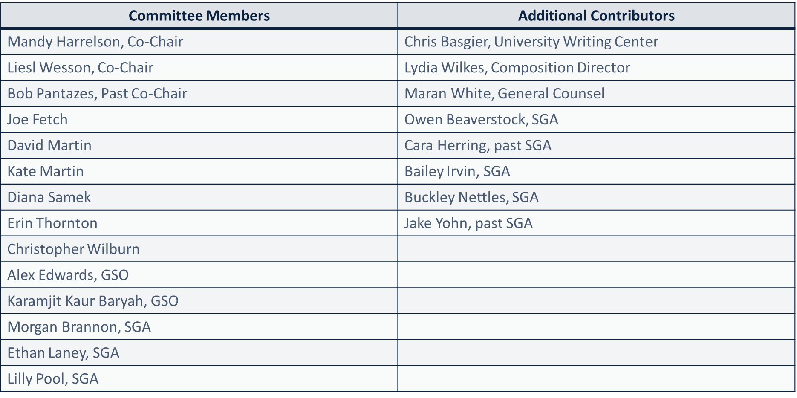
acknowledgements

Slide 44

Thank you!
Dr. Mark DeGoti, Office of the provost
Aub.ie/integrity

Slide 45

Thank you
auburn.edu

Slide 46


